Slide 1

RAPID INTERVENTION WITH GTN IN HYPERACUTE STROKE TRIAL: RIGHT
New Trial Envelopes: April 2011
Notes:
1
54
54

Slide 2
Right: Envelope Replacement- Apr 2011
Start using the new white envelopes from 07 April 2011
Stop using the old brown envelopes from 07 April 2011
If you find any brown envelopes after 07 April 2011- please post them by EMAS internal mail to my address- it has my details on the front.

Slide 3
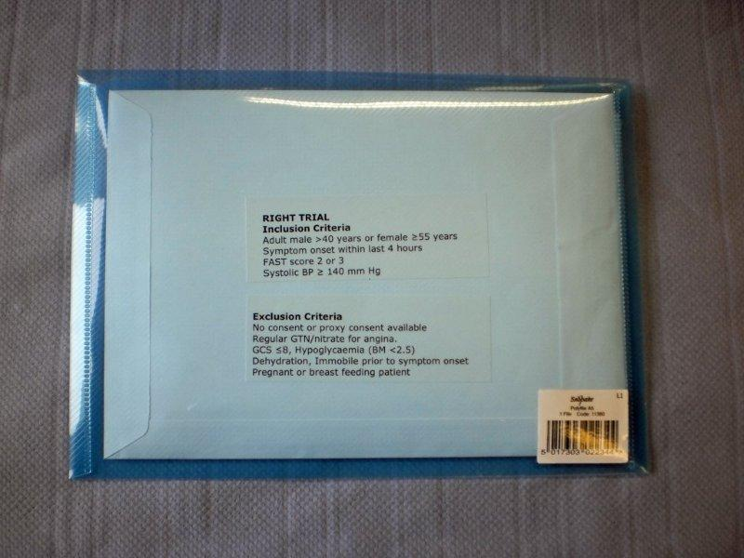
The new envelopes are in a transparent blue plastic folder. The inclusion and exclusion criteria are visible from outside the folder.

Slide 4
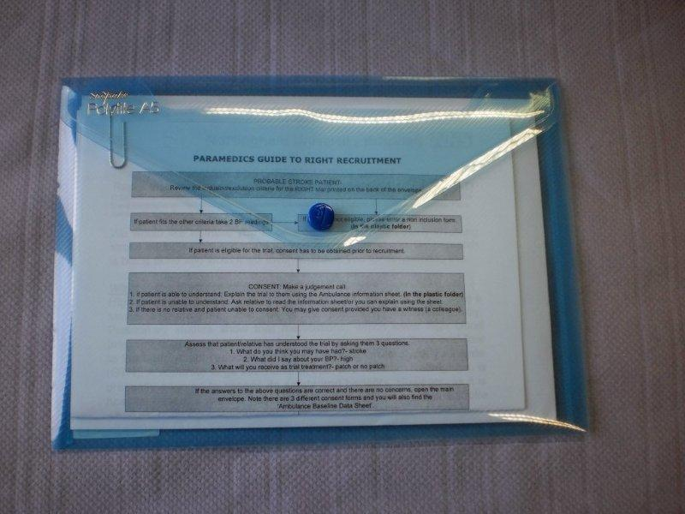
The paramedic’s guide to recruitment, non inclusion form and the ambulance information sheet are in the plastic folder. Importantly, you only need to open the folder and not the envelope to access these forms.

Slide 5
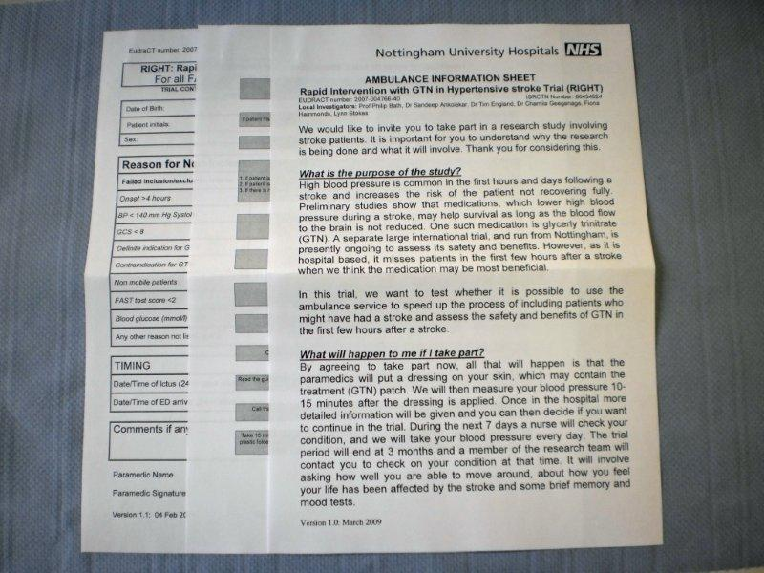
Use the information sheet to explain the trial to patient. If patient is FAST positive and is not randomised for whatever reason, please fill a non inclusion form. If eligible and willing to consent, you may open the main envelope to access the consent forms. The paramedics guide will explain this in more detail.

Slide 6
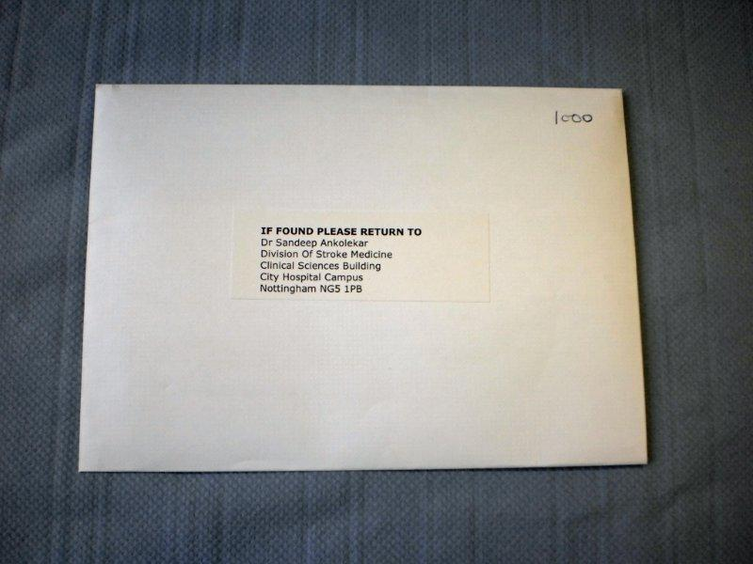
The envelope has my address in the front and a 3 digit number (the one shown below is a sample)

Slide 7
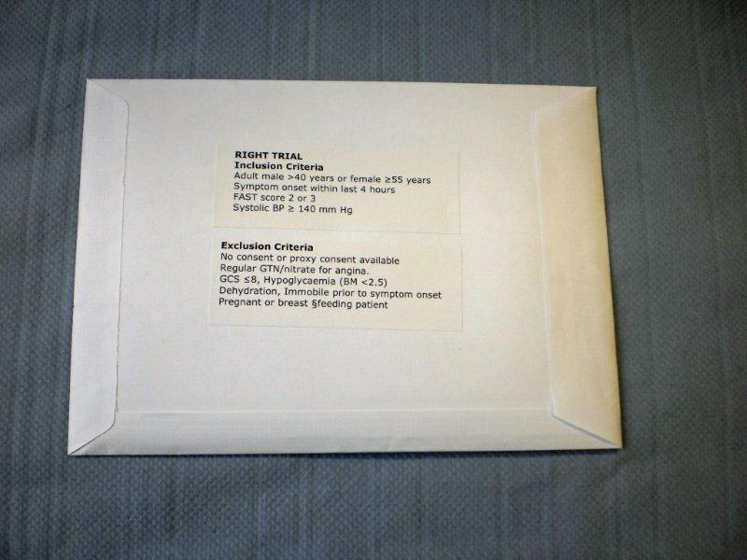
The inclusion and exclusion criteria on the back of the envelope which can be reviewed through the transparent plastic folder as shown previously.

Slide 8
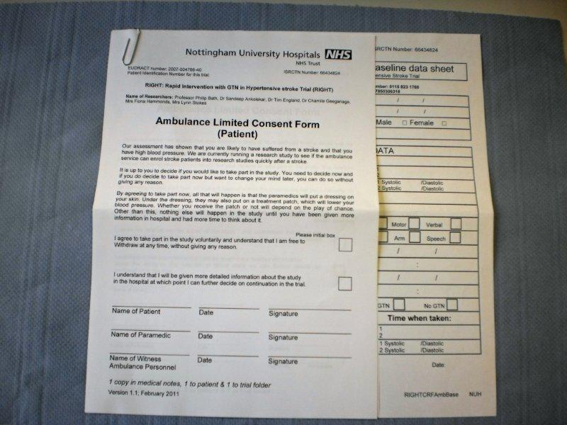
If patient is eligible and willing, open the main envelope. It has 3 consent forms and the baseline data sheet. First fill the consent form. Patient is now in the trial. Next fill the baseline data sheet (except randomisation details) before proceeding to open the inside smaller envelope.

Slide 9
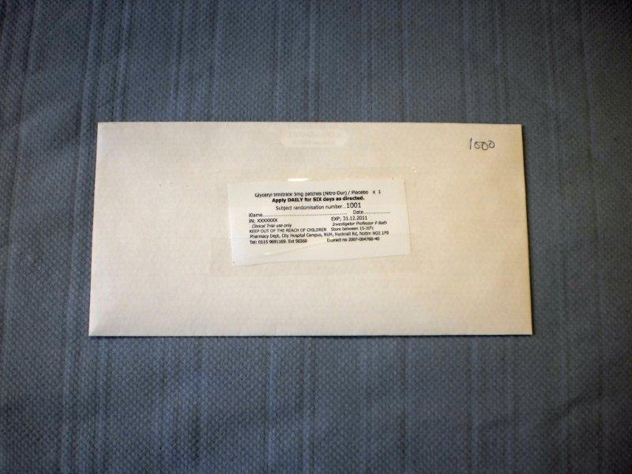
The small envelope should ONLY be opened after the consent form and baseline data sheet are filled. The time of opening this envelope is the time of randomisation.

Slide 10
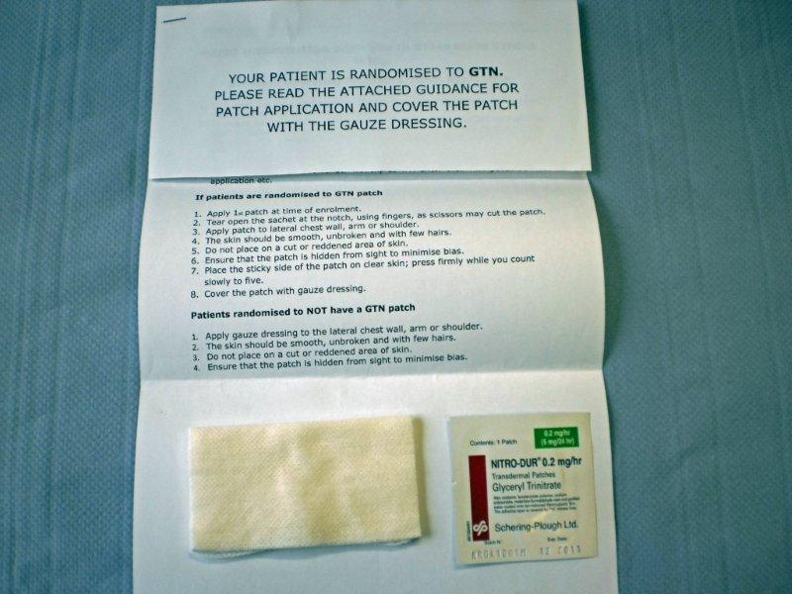
The inside envelope will contain the randomisation details of the patient and the gauze dressing with or without a GTN patch.

Slide 11
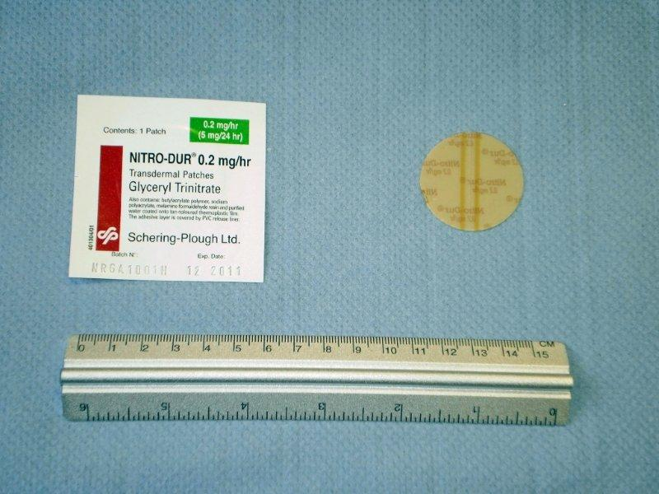
Bend the circular patch at the diameter (2 brown lines). After it snaps, peel open the patch and apply it on the patient’s skin as per the accompanying instructions.

Slide 12
Call Berman and then inform Sandeep about the recruitment.
If out of hours, you have a potential patient, check with Sandeep to ensure availability before randomising patient.
Take a reading 15 minutes after randomisation and enter it on the data sheet.
Handover care to Sandeep/research nurses at the hospital.

Slide 13
Thank you

