Slide 1

RAPID INTERVENTION WITH GTN IN HYPERACUTE STROKE TRIAL: RIGHT
Division of Stroke, University of Nottingham
East Midlands Ambulance Service
Notes:
1
54
54

Slide 2
Outline of the Presentation
Trial Background
Aims
Trial overview
Your role
Qualitative study

Slide 3
Introduction
Third largest cause of death in UK
110,000 strokes every year
20 % require institutional care
Further 25 % are permanently disabled
2.8 billion pounds- direct costs to NHS

Slide 4
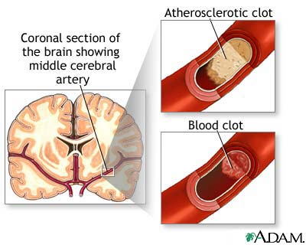
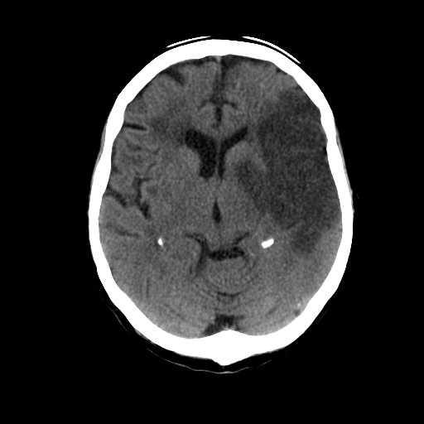
Ischaemic stroke
Notes:
Finger moving, count or threat
Can be difficult in aphasia
If they look at the side – score normal
Will need encouragement

Slide 5
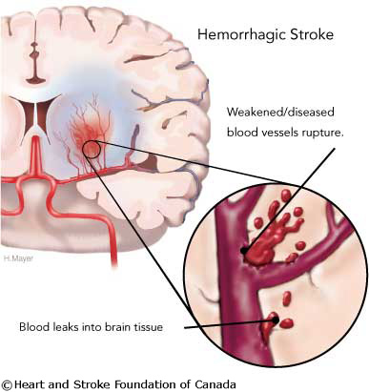
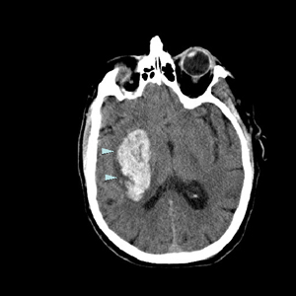
Haemorrhagic Stroke

Slide 6
Management of Acute Stroke
Specific treatment
  Ischaemic
  Haemorrhagic
Supportive treatment
  Similar in both ischaemic or haemorrhagic strokes
    Glucose
    Temperature
    Oxygenation
    Nutrition
    Neuroprotection
    Blood pressure

Slide 7

SBP in acute ischaemic stroke: IST

Slide 8
Systolic BP & outcome: IST
N=17,398
Leonardi-Bee et al. Stroke 2002;33:1315-20
Notes:
U-shaped
Only 5% low BP, I.e. not clinical burden
Need to focus on high BP

Slide 9
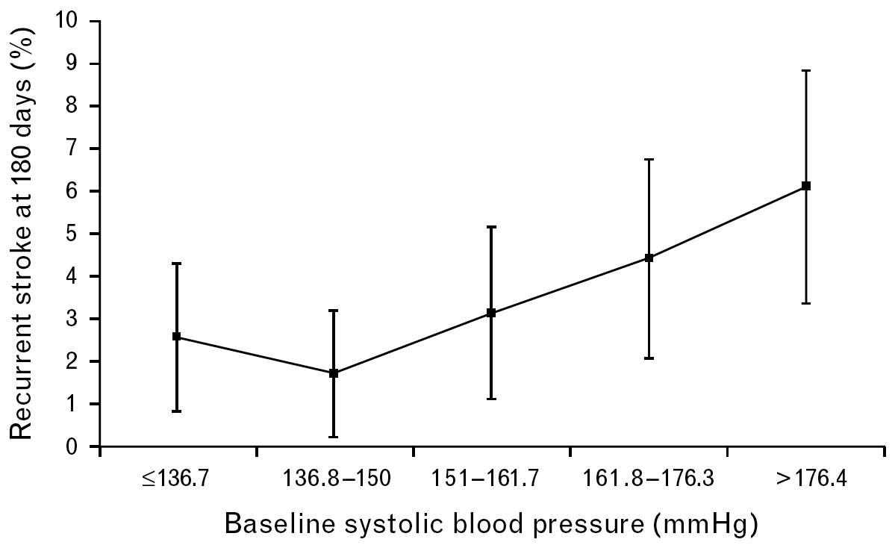
SBP & early recurrence: TAIST
10
N=1,384
Sprigg et al. J Hypertension 2006;24:1413-17

Slide 10
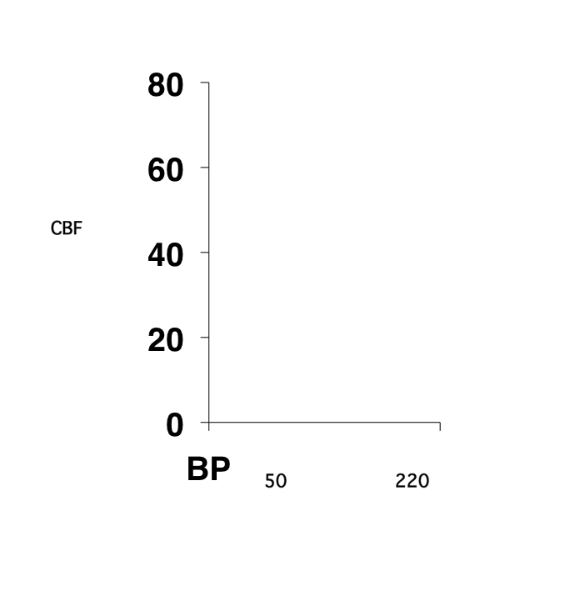
Cerebral blood flow
Cerebral perfusion normally maintained independent of BP
Curve right-shifted in chronic high BP
Autoregulation lost following stroke
Local perfusion becomes dependent on BP

Slide 11
Nitric Oxide
Lowers blood pressure in acute stroke
Maintains regional cerbral blood flow
Anti leucocyte agent
Neuroprotective
May attenuate neuronal apoptosis
Enhances neurogenesis and angiogenesis
Reduce infarct size

Slide 12
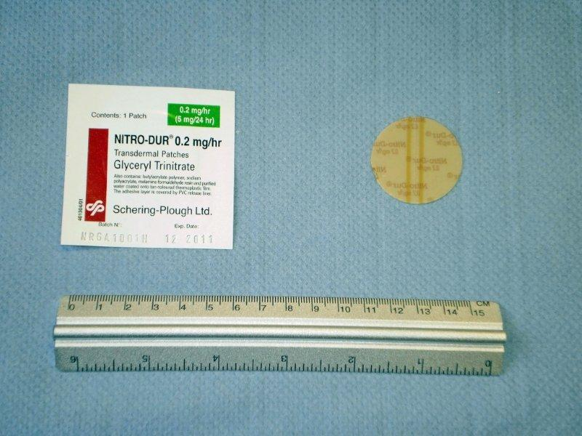
GTN patch

Slide 13


Efficacy of Nitric Oxide in
Stroke (ENOS)
Assess if lowering blood pressure improves outcome
Interventions (for 7 days):
  Transdermal glyceryl trinitrate (5 mg daily) or control
  Continue / stop prior antihypertensive therapy
Ischaemic or haemorrhagic stroke within 48 hours
5,000 patients
Internet: Randomisation, data collection, trial management
2615 patients, 131 centres, 17 countries, 5 continents (01/11/2011)
Start-up funding by Hypertension Trust, BUPA Foundation
Main phase funding by MRC Nov 2006-Oct 2011
www.enos.ac.uk/

Slide 14
Why RIGHT?
Brain death after stroke each minute !!
  2 million neurons
  14 billion synapses
  7.5 million myelinated nerve fibres
Brain ages 3.6 years each hour
Randomisation in ENOS
  < 10 % within first 12 hours
Saver JL Stroke 2006; 37(1) p 263-266

Slide 15
Ambulance Based Stroke Trial
None in the UK !!
FAST MAG Pilot Study- US
Brings up a whole lot of new challenges
  Diagnosis
  Recruitment
  Transfer of Care
  Feasibility
  Patient perception
  Paramedics perception

Slide 16
TRIAL OVERVIEW
Ambulance-based
Single centre trial
80 patients with hypertensive stroke
Single-blind,
Randomised controlled trial
Blinded outcome assessment.

Slide 17
AIMS AND OBJECTIVES
Primary Aim
To assess the feasibility of using the ambulance service to test and deliver treatment for stroke in the hyper acute setting
Secondary Aims:
To assess the effects of GTN on blood pressure, pulse pressure (PP), rate pressure product (RPP) and surrogate markers of efficacy in blood in the hyperacute setting

Slide 18
Outcomes
Primary outcome
  Effects of GTN on BP at 2 hours post treatment.
Secondary outcomes
  Ambulance trial logistics:
    Times from ictus to randomisation in ambulance; ictus to ED arrival, and randomisation to ED arrival.
    Haemodynamic effects of GTN
  In hospital:
    Scandinavian Stroke Scale at 2 hours;
    Length of stay in hospital;
    Death
    Disability

Slide 19
Inclusion/Exclusion Criteria
Inclusion Criteria
  Adult male patient > 40 years or female patient ≥ 55 years
  Symptom onset within last 4 hours
  FAST score 2 or 3
  Systolic BP ≥ 140 mm Hg
Exclusion Criteria
  No consent or proxy consent available
  Has an indication for taking GTN
  Adult male <40 years or female < 55 years
  GCS ≤ 8
  Non-ambulatory prior to symptom onset
  Hypoglycaemia (BM <2.5)
  Clinically dehydrated
  Pregnant or breast feeding patient

Slide 20
Your Role (1)

Slide 21
Your Role (2)

Slide 22
Your Role (3)

Slide 23
In the Hospital

Slide 24
Forms
Information Sheets
  Ambulance Information Sheet
  Inclusion/Exclusion Criteria Sheet
Ambulance Consent Forms
  Patient
  Relative
  Paramedic
Data Entry Form
  Ambulance Baseline Data
  Non Inclusion Form

Slide 25
What was your experience?
  Qualitative Research component
    Advised by ethics committee
    Supported by EMAS
Paramedic experience
    How did you feel about participating in the trial?
    Do you feel recruitment delayed usual provision of care for the patient?
    What was the main difficulty in randomising?
    Was it difficult approaching the patient?
    Were you uncertain if the patient was suitable?
    Were you uncertain if the patient had a stroke?
    Were you uncertain about the trial?

Slide 26
Patient perspective
  More challenging – ethics
  Large qualitative study
  Still undecided
All paramedics welcome to participate
  Will involve one hour interview
  Experience about the trial
  Will be done once or twice during the whole trial
  Interview will be recorded

Slide 27
Trial Status
24 patients recruited (target 80)
Approvals
  Ethics
  EMAS
  MHRA
  NUH R&D
Website
  www.right-trial.org
Contacts
  righttrial@nottingham.ac.uk
  sandeep.ankolekar@nottingham.ac.uk
  Telephone:0115 8231769/07850306318
  Michael.fuller@emas.nhs.uk/ 07824503737

Slide 28
Thank you

